Slide 1
KEYLOGGER
Presented By:
MATHEW HAYDEN S
Computer Science and Engineering
DMI College of Engineering

Slide 2
OUTLINE
Problem Statement
Proposed System/Solution
System Development Approach
Algorithm & Deployment
Result
Conclusion
Future Scope
References

Slide 3
Problem Statement
The modern digital landscape presents challenges in monitoring and tracking user activities on computing devices. Without adequate mechanisms in place, there is a lack of visibility into user interactions, posing risks such as unauthorized access, data breaches, and misuse of resources. Moreover, in scenarios such as parental oversight or employee management, ensuring accountability and safeguarding against inappropriate behavior or security threats becomes increasingly difficult. This necessitates the development of solutions capable of discreetly capturing and recording user inputs, thereby enabling proactive measures for security, productivity enhancement, and regulatory compliance

Slide 4
Proposed Solution
Keyloggers are software tools designed to capture and record keystrokes entered on a computer or mobile device. They operate discreetly in the background, logging every key pressed by the user. Keyloggers can be classified into two main types: hardware-based and software-based. Hardware keyloggers are physical devices inserted between the keyboard and the computer, while software keyloggers are installed as programs on the target device.
Keyloggers serve various purposes, including monitoring user activities for security reasons, detecting unauthorized access, tracking productivity, and facilitating parental control. Despite their utility, keyloggers raise privacy concerns and ethical considerations due to their potential for misuse and invasion of personal privacy. Therefore, responsible usage and legal compliance are essential considerations in deploying keylogging solutions

Slide 5
System Approach
System Requirements:
Key Logging: Capture and record keystrokes entered on the target device.
Data Handling: Store logged keystrokes in text files (key_log.txt, key_log.json) for further processing.
User Interaction: Utilize tkinter for building a graphical user interface (GUI) for starting and stopping the keylogger.
Event Handling: Implement functions for handling key press and release events using the pynput library.
File Management: Write logged keystrokes to text files in real-time for immediate access and analysis.
Libraries Required:
tkinter: GUI development for user interaction.
pynput: Event handling for keylogging functionalities.
json: Serialization and deserialization of key logs for storage in JSON format.
By adhering to these system requirements and utilizing the specified libraries, we can systematically develop and deploy a functional keylogger system based on the provided code.

Slide 6
Algorithm & Deployment
Algorithm:
Initialize global variables and flags for tracking key events and states.
Define functions for capturing key press and release events (on_press and on_release).
Implement functions to handle starting and stopping the keylogger (start_keylogger and stop_keylogger).
Utilize the pynput library to monitor keyboard events and record keystrokes.
Store captured keystrokes in text files (key_log.txt, key_log.json) for further analysis.
Deployment:
Ensure all necessary libraries (tkinter, pynput, json) are installed.
Run the Python script containing the keylogger code on the target device.
Upon execution, a GUI window will appear with options to start and stop the keylogger.
Click "Start" to initiate the keylogging process.
Press keys on the keyboard to capture and log keystrokes in real-time.
Click "Stop" to terminate the keylogger and end the logging process.
Access the generated text files (key_log.txt, key_log.json) to view the recorded keystrokes.

Slide 7
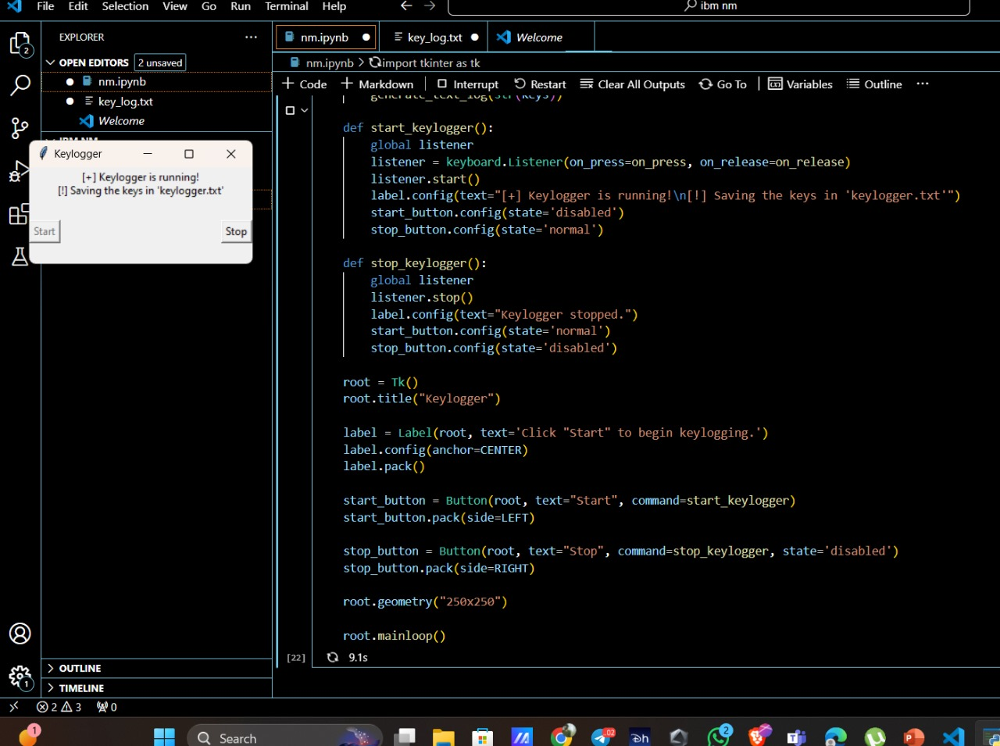
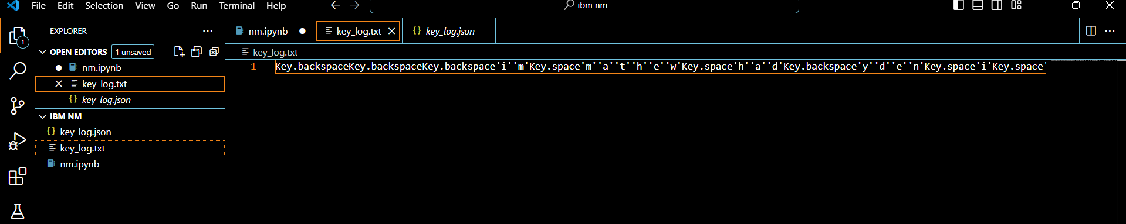
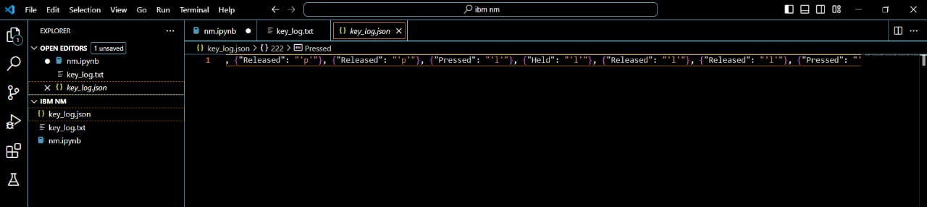
Result
The implementation of the keylogger system allows for the discreet capture and recording of keystrokes on the target device, facilitating user activity monitoring and analysis.

Slide 8
Conclusion
The implemented keylogger system offers a covert means of capturing and recording keystrokes, providing valuable insights into user activities. While effective for monitoring purposes, challenges such as privacy concerns and ethical considerations arise, necessitating responsible usage and legal compliance. Potential improvements include enhancing data storage methods for improved security and exploring additional features for comprehensive user activity tracking. Despite challenges, the importance of such systems in security enforcement and behavior analysis cannot be understated, emphasizing the need for continued refinement and ethical deployment

Slide 9
Future scope
Enhanced Logging: Capture additional data like mouse clicks and application usage.
Remote Monitoring: Monitor user activity across devices from a central location.
Anonymization: Protect privacy by anonymizing captured information.
Behavior Analysis: Use AI to detect and prevent suspicious behavior.
Real-time Alerts: Receive alerts for unauthorized activities.
Cross-platform Support: Extend keylogging to various operating systems.
User Authentication: Restrict keylogging to authorized users.
Reporting: Generate detailed insights for compliance and auditing.

Slide 10
References
Python Software Foundation. (2022). Python 3 Documentation. Retrieved from List and cite relevant sources, research papers, and articles that were instrumental in developing the proposed solution. This could include academic papers on bike demand prediction, machine learning algorithms, and best practices in data preprocessing and model evaluation.
Tkinter Documentation. (2022). Retrieved from List and cite relevant sources, research papers, and articles that were instrumental in developing the proposed solution. This could include academic papers on bike demand prediction, machine learning algorithms, and best practices in data preprocessing and model evaluation.
Pynput Documentation. (2022). Retrieved from List and cite relevant sources, research papers, and articles that were instrumental in developing the proposed solution. This could include academic papers on bike demand prediction, machine learning algorithms, and best practices in data preprocessing and model evaluation.
JSON Documentation. (2022). Retrieved from List and cite relevant sources, research papers, and articles that were instrumental in developing the proposed solution. This could include academic papers on bike demand prediction, machine learning algorithms, and best practices in data preprocessing and model evaluation.

Slide 11
THANK YOU

